Slide 1



Development of a Single Official UK House Price Index
Friday 11th March 2016

Slide 2
Objectives for today
Background
Progress Update
Enhancements to the NI RPPI
Notes:
The project to create a single UK house price index has been led by the Office for National Statistics (ONS). They ran a formal consultation process, with the Northern Ireland event held here in November 2014. The consultation proposed a new methodology encompassing all aspects of the methodology and publication process, and sought views on the proposed changes. The responses from the workshops and individual responses were reviewed and formally reported on in March 2015. This information session is to update you as to the final form of the methodology and publication process from the NI perspective.
The ONS are running a similar information session in London on 30th March 2016. Ideally, we would have held our information session afterwards so that we could include the changes to the ONS figures in our presentation. However, due to the NI elections in May, we had to hold the NI user event before 30th March.

Slide 3




Background
Repeat Sales Method
NI RPPI
Single Official UK HPI
Sample of Mortgages
Notes:
One of the main drivers for the single Index was to remove the confusion caused by the different results produced by the different methodologies. This slide shows where we were at the start of the consultation process, with four official House Price Index publications
Starting from top left we have:
Our Quarterly Northern Ireland Residential Property Price Index – hedonic regression, geometric mean, cash and mortgage sales
Land Registry House Price Index: Monthly report – Repeat Sales Method – hedonic regression using only sales of properties which have sold more than once
ONS Monthly House Price Index – Sample of Mortgage transactions – no cash sales, hedonic regression and arithmetic mean
Official Quarterly Housing Market Statistics – Registers of Scotland – a set of housing statistics including median prices and sales volumes (no official index produced).

Slide 4


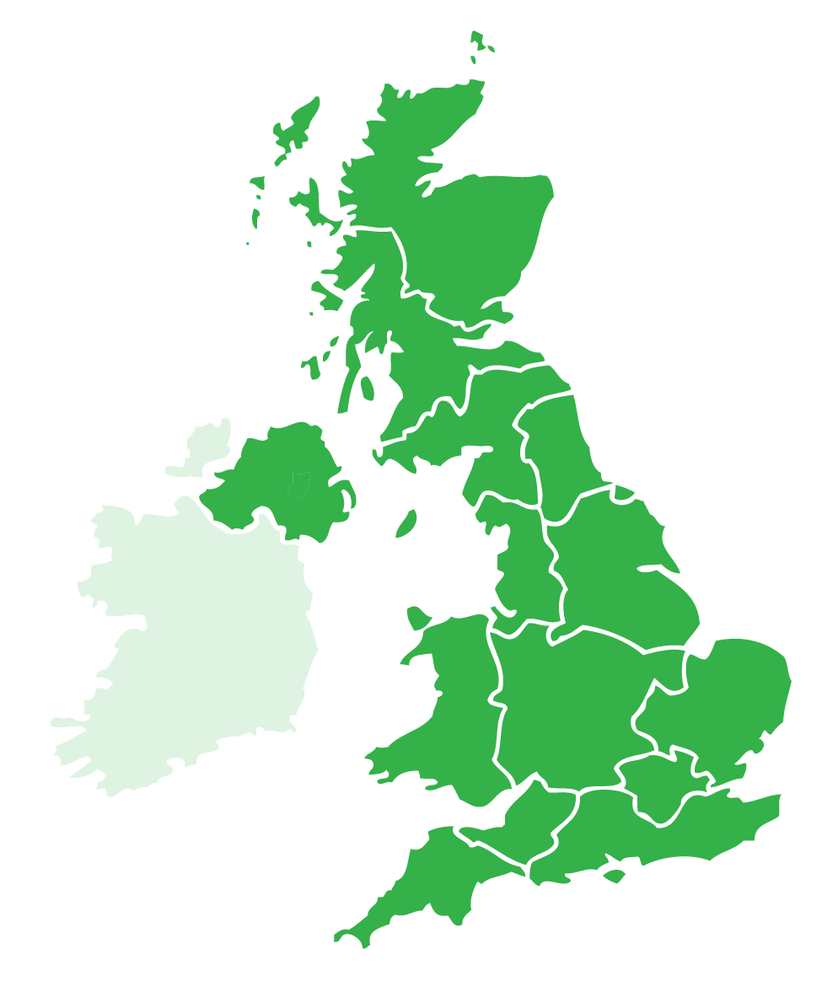


Market Price at Completion
House Prices & Inflation
UK Coverage
Single Official UK HPI
Timely Statistics
Robust sub-regional estimates
Notes:
One of the outcomes of the consultation process was clarity around what users really wanted from a new single Index
The new Index needs to:
Represent the prevailing market price of residential property at completion of sale;
Measure both house prices and house price inflation based on the price paid for transacted properties;
Have UK coverage – therefore making valid comparisons possible across the UK
Provide robust sub-regional estimates;
Be timely with minimal revisions;
The new Index will also:
Provide a consistent index series to enable trend analysis;
Be available as a seasonally adjusted and unadjusted series;

Slide 5

Single Official UK House Price Index
Based on the transaction price of residential property at market value
Includes cash as well as mortgage sales
Best Practice Method – Hedonic Regression & Geometric Mean
NI to provide Quarterly resultant prices/indices for inclusion in monthly UK series
Notes:
Everyone was already publishing on transactional price at market value
Using both Cash and mortgage sales – brings ONS in line with NI and Land Registry (LR)
Hedonic regression and geometric mean –moves ONS from arithmetic to geometric mean and a completely different methodology for Land Registry
Not possible for NI to produce reliable information on a monthly basis as the number of transactions is too low. So, our data will be held constant in the months that we are not producing our quarterly statistics.

Slide 6
Methodology Detail: Regression Model
Size (m²)
Build Type (Private/Public) (NI only)
Type of Property (Detached, Apartment etc)
Location (GB – Local Authority; NI – LPS Housing Market Areas)
ACORN classification (socio-demographic description)
Number of rooms (GB only)
New/Pre-Owned Dwelling Indicator
Notes:
The final variables to be included in the model mean that there are differences for all the producers between what we have previously used and what will be used going forward.
Housing Market areas were defined by Land & Property Services Valuation staff for the last domestic revaluation in 2007. As part of the computer assisted mass appraisal process homogeneous housing were grouped together into areas of similar value.
ACORN is a socio-demographic classification of postcode areas created by CACI. It is based on 2/3 financial sector data and 1/3 census data. It provides a qualitative description of areas within the UK.
New Dwelling Indicator flags the first sale of a new property

Slide 7





Methodology Detail: Weights
  ‘fixed basket’ of properties
  Updated to reflect change in mix of properties being traded
  Keeps prices representative of current trend in property market
  Q: 1 year or 3 years of sales?
  A: 1 year (previous calendar year)
  No Change to current NI RPPI
Notes:
One of the big discussion areas in the consultation was around the weights used to produce the Index.
The mix of properties sold will vary from one time period to another. So, to measure pure price change the mix of properties must be fixed (where mix relates to location, size, type of property, etc.).
The aim is to keep the mix as representative of current trends as possible
The basket which represents the mix of properties is typically referred to as weights – and these are used in the aggregation of the prices
It is important that the weights are as representative as possible – if the period covered by the weights is too short, the weights may become too volatile and fluctuate due to short-term effects in the housing market (also possibility of there being too few transactions to be statistically sound).
If the weights reference period is too long, the index becomes unresponsive to changes in the market.
The question about how many years’ worth of transactions to use for weighting was raised in both the User Consultation (section 2.45) and the Peer review by the Government Statistical Service Methodological Advisory Committee (GSS MAC). This question has been considered further by the Working Group in terms of justifying the robustness and potential variability in using 1, 2 or 3 years worth of transactions for the weighting. A summary of the analysis is presented here.
Analysis showed the effect on :
annual percentage change in price was minimal using either 1, 2, or 3 year weights
Average price levels varied more when using 1 year than 2, or 3 years weights. However, the variation was not significant
The number of transactions within each area within each 1 year was robust enough to calculate weights
Due to the importance of being as representative as possible to current trends – one year was chosen.

Slide 8

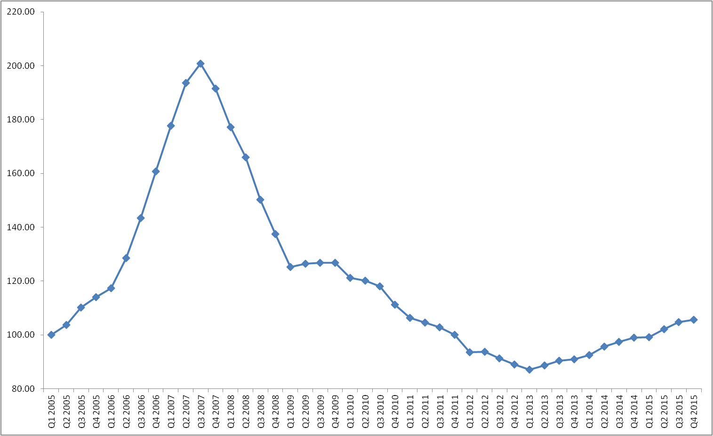
Methodology Detail: Published Prices
In-Year Index
Q1 2005
Q2 2005
Q3 2005
Q4 2005
100
Chain Linked Index
102
103
106
Notes:
Mix-adjusted prices produced each period and used to calculate in-year indices (always compare to Q1 of current year)
In-year indices linked together to produce long term and comparable index (chain-linking)
Each Q1, the basket of houses sold is updated to reflect latest mix of properties and fixed for the year

Slide 9
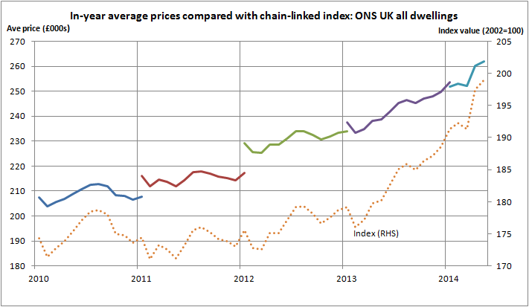
Methodology Detail: Published Prices
Notes:
You may remember this graph from the user consultation – which uses ONS data and therefore shows monthly data.
It shows the average mix-adjusted price calculated based on each year’s fixed basket of house sales. It also shows the consistent chain linked price index computed using these prices.
This shows how the change in prices is mirrored in the change in the Index.
Note that in January, two prices are calculated – one using the ‘old’ mix of properties (to give a consistent December to January movement) and one using the new mix (to give a consistent January to February movement).
Key point is comparability – the price in March 14 is not directly comparable to March 10 as represents a different mix of properties

Slide 10

Methodology Detail: Published Prices
Comparable Prices
In-Year Current Prices
All Prices
Notes:
The lack of comparison of in-year mix-adjusted prices between years has been identified as an issue for users, with feedback from the User Consultation exercise supporting the publication of a set of price levels that are comparable over time.
As a result, the new UK HPI (and therefore the NI RPPI) will publish a comparable set of price data by up-rating the price at the reference period by the movement in the Index. This is a similar approach to that used in the current Land Registry HPI.

Slide 11
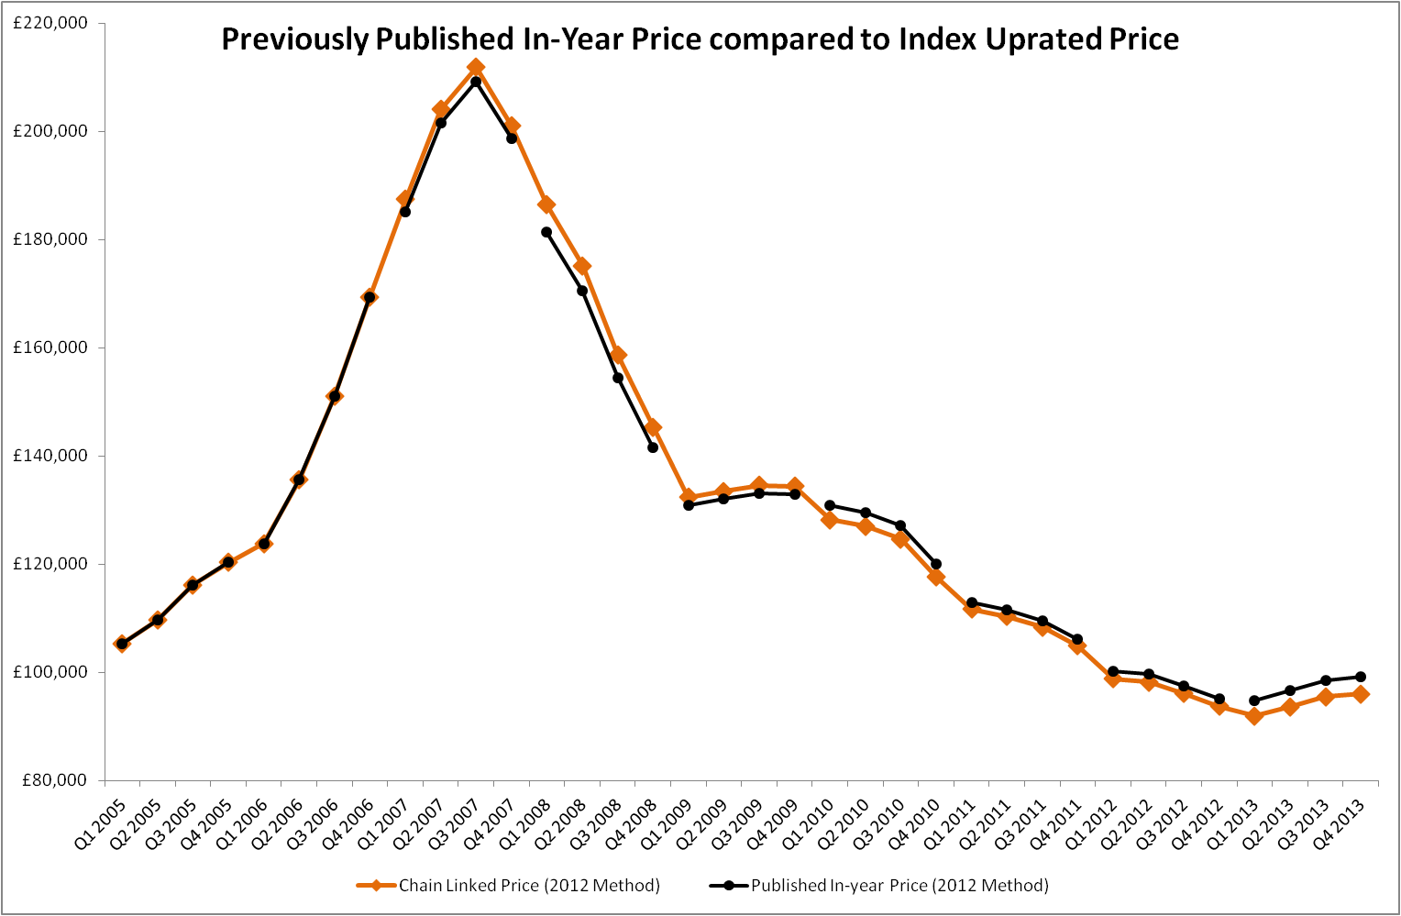
Methodology Detail: Published Prices
Notes:
As you can see there is not a lot of difference between the prices previously published within the NI RPPI (black broken line) and the price taken at Q1 2005 and up-rated by the index (orange line).
However, the advantage of publishing the up-rated prices is that these prices will be comparable over time
In this graph the 2012 method refers to the current NI RPPI methodology
Information is provided only up to end of 2013. This allows us to show comparisons which cover the key turning points of Q3 2007 and Q1 2013 but do not provide very recent data. This is to comply with pre-release access legislation not to indicate the likely value or direction of travel of, as yet, unpublished figures.

Slide 12
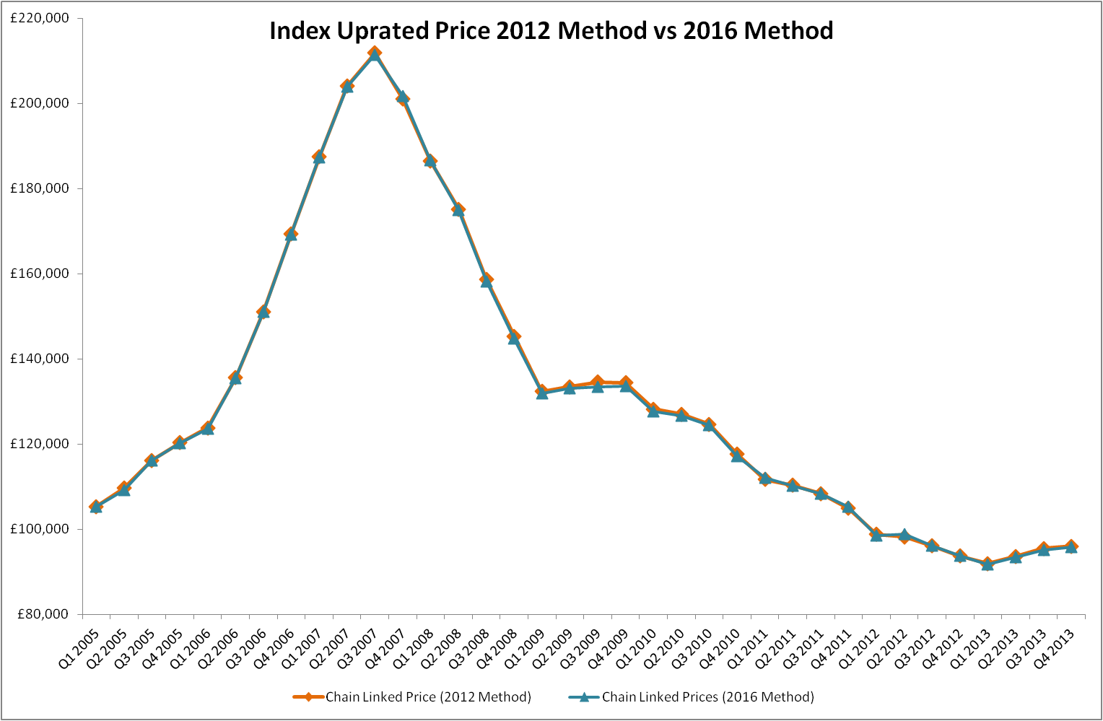
Impact of Methodology Changes
Notes:
Following on from the previous slide
Again, the orange line shows the up-rated prices which we could have produced under the current methodology (2012 method) and the up-rated prices produced under the new methodology.
This shows that the up-rated (Chain Linked) Prices that we could have published do not differ significantly from those we will be publishing in May 2016
As the constant prices and the Index are two expressions of the same thing, this slide also quantifies the impact of moving from the existing NI RPPI to the new single UK HPI methodology. There will be very little difference in the published figures for Northern Ireland.

Slide 13
Single Official UK HPI - Outputs
Dwelling Type (detached, apartment etc)
Property Type (new build or pre-owned)
Local Government District
Volume of sales
Series will be quarterly for NI and monthly for UK
Additional Series available for GB Only
Cash or mortgage purchases
Type of buyer (first time / previous home owner)
Notes:
This slide uses the language of the UK HPI.
Each month there will be a report/bulletin providing commentary and background information for the latest published data. This will also be accompanied by full tables of data for the various breakdowns detailed in the slide along with interactive analysis tools. The exact specification of these additional tools will be defined over the next few months and explained to users in due course.

Slide 14
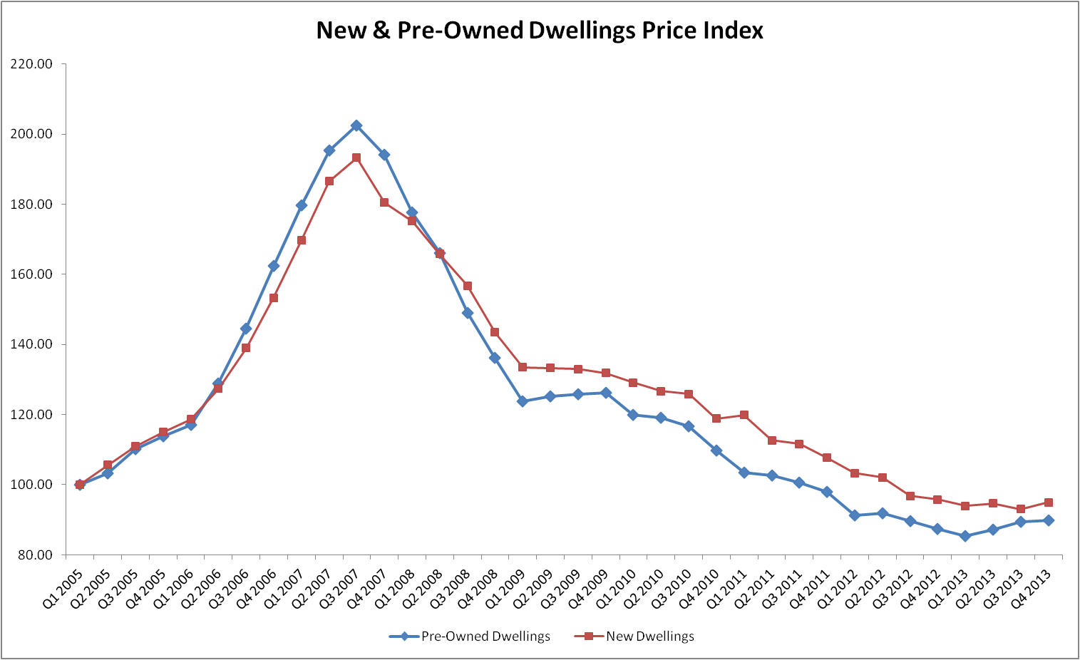
Single Official UK HPI - Outputs
Notes:
In order to align with the UK HPI Methodology LPS needed to find a way to identify the first sale of a new property.
Using the date the property was entered into the valuation list and the sale date, LPS Statistics Branch has created a flag to identify the first sale of a new property.
We are now able to produce a house price index for both new and pre-owned dwellings.
The index of new vs pre-owned dwellings can be seen for the period Q1 2005 to Q4 2013
New Dwelling Prices follow a similar trend to the pre-owned dwellings however the prices did not rise as high in Q3 2007 and they did not fall as low between Q3 2007 and Q1 2013. Prices of new dwellings saw a much steadier decrease since the peak and the index remained higher than for pre-owned properties

Slide 15




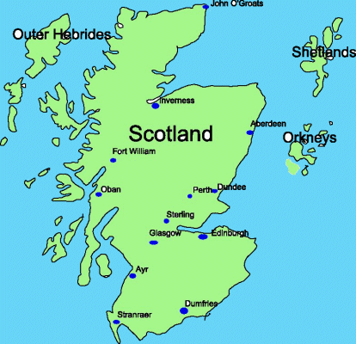
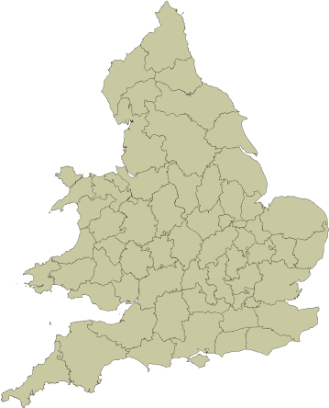
Single Official UK HPI - Outputs
UK HPI Report
Website
Website
Interactive Search Tool
England & Wales Analysis
Price Paid Dataset (GB)
Notes:
A report giving the UK & Regional House Price Indices, Price Levels, Sales Volumes and annual changes will be available on the GOV.UK website.
Due to legislation, ONS is unable to publish on the GOV.UK website. Therefore Land Registry is officially the organisation that will publish the UK HPI.
Detailed statistics for lower level geographies within each region will be published separately. The NI RPPI detailed statistics and overall NI report will still be available from the DFP website with a link from the GOV.UK website.
Registers of Scotland will continue to publish their quarterly simple mean and median prices via the Registers of Scotland website
The current Land Registry Interactive search tool will be amended to cover the UK for the first time, i.e. Prices and index levels to local government district level in all regions can be searched and compared.
The current price paid dataset from Land Registry which details the price paid for all individual transactions will still only include transactions across GB

Slide 16

Single Official UK HPI – Presentation Changes
Seasonal Adjustment
  UK & Regional Price series to be tested by ONS
  If seasonality is present a seasonally adjusted series will be published on GOV.UK
Update Reference Period
  Q1 2005 will move to Q1 2015
Change to Publication Day
  NI RPPI will be released on a TUESDAY from 17th May 2016
Notes:
Note the change to the NI RPPI publication day – this will be a Tuesday from May onwards

Slide 17
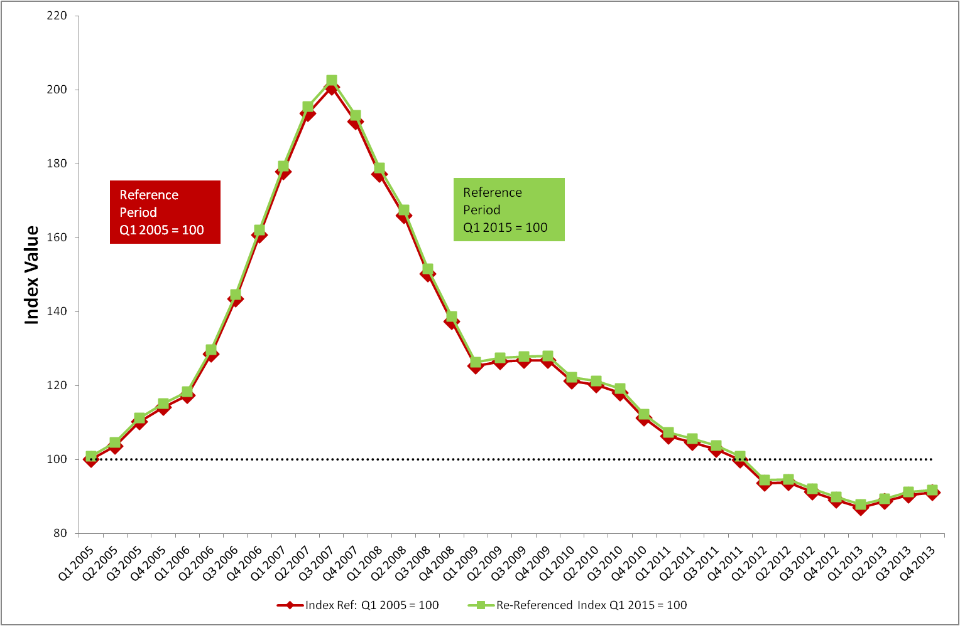
Presentation Details: Re-Referenced Index
Notes:
Since its launch the NI RPPI has been referenced to Q1 2005 i.e. Q1 2005 = 100 and all price movements have been calculated from there
In order to align with the UK when they publish in June 2016 the NI RPPI will be published in May 2016 with a reference period of Q1 2015, i.e. Q1 2015 = 100
The graph shows there is minimal difference between the index values using the different reference period. It is hard to see in the chart but the green index line has been scaled upwards slightly due to the percentage difference between the index value at Q1 2015 and the index value at Q1 2005

Slide 18
Single Official UK HPI – Presentation Changes
Removal of Market Sensitive Designation
    Applicable to NI only
Presentation of a Consistent Back Series
Notes:
Data on house prices needed for the new methodology is available for different time periods across the UK.
NI data is only available from January 2005, whereas Land Registry data for England & Wales is available from Jan 1995.
The table above shows the time periods which will be calculated for the new index (Recalculated back series) and the ONS will derive a back series to link previously published price data with the most recent index series.

Slide 19



Opportunity to Review
NUTS3 regions in Northern Ireland
Rolling annual Median Prices at 26 Councils
  Propose to discontinue house price statistics at these levels
  Urban and Rural Areas
      Propose to remove statistics at this level from the report but keep in the Detailed Statistics
Notes:
Post Information Session Note:
Information at NUTS3 area level is required for certain users. Therefore we will continue to publish this information in the detailed statistics section of the website.

Slide 20



Single Official House Price Index
Comparable from
UK HPI
Notes:
Although the NI RPPI will be released on Tues 17th May 2016 using the new methodology, figures will not be comparable with the rest of the UK until they publish on 14th June 2016

Slide 21
Single Official House Price Index
ONS - Development of a Single Official House Price Index
Impact on previously published UK House Prices will be available at this link from 30th March 2016

